Slide 1
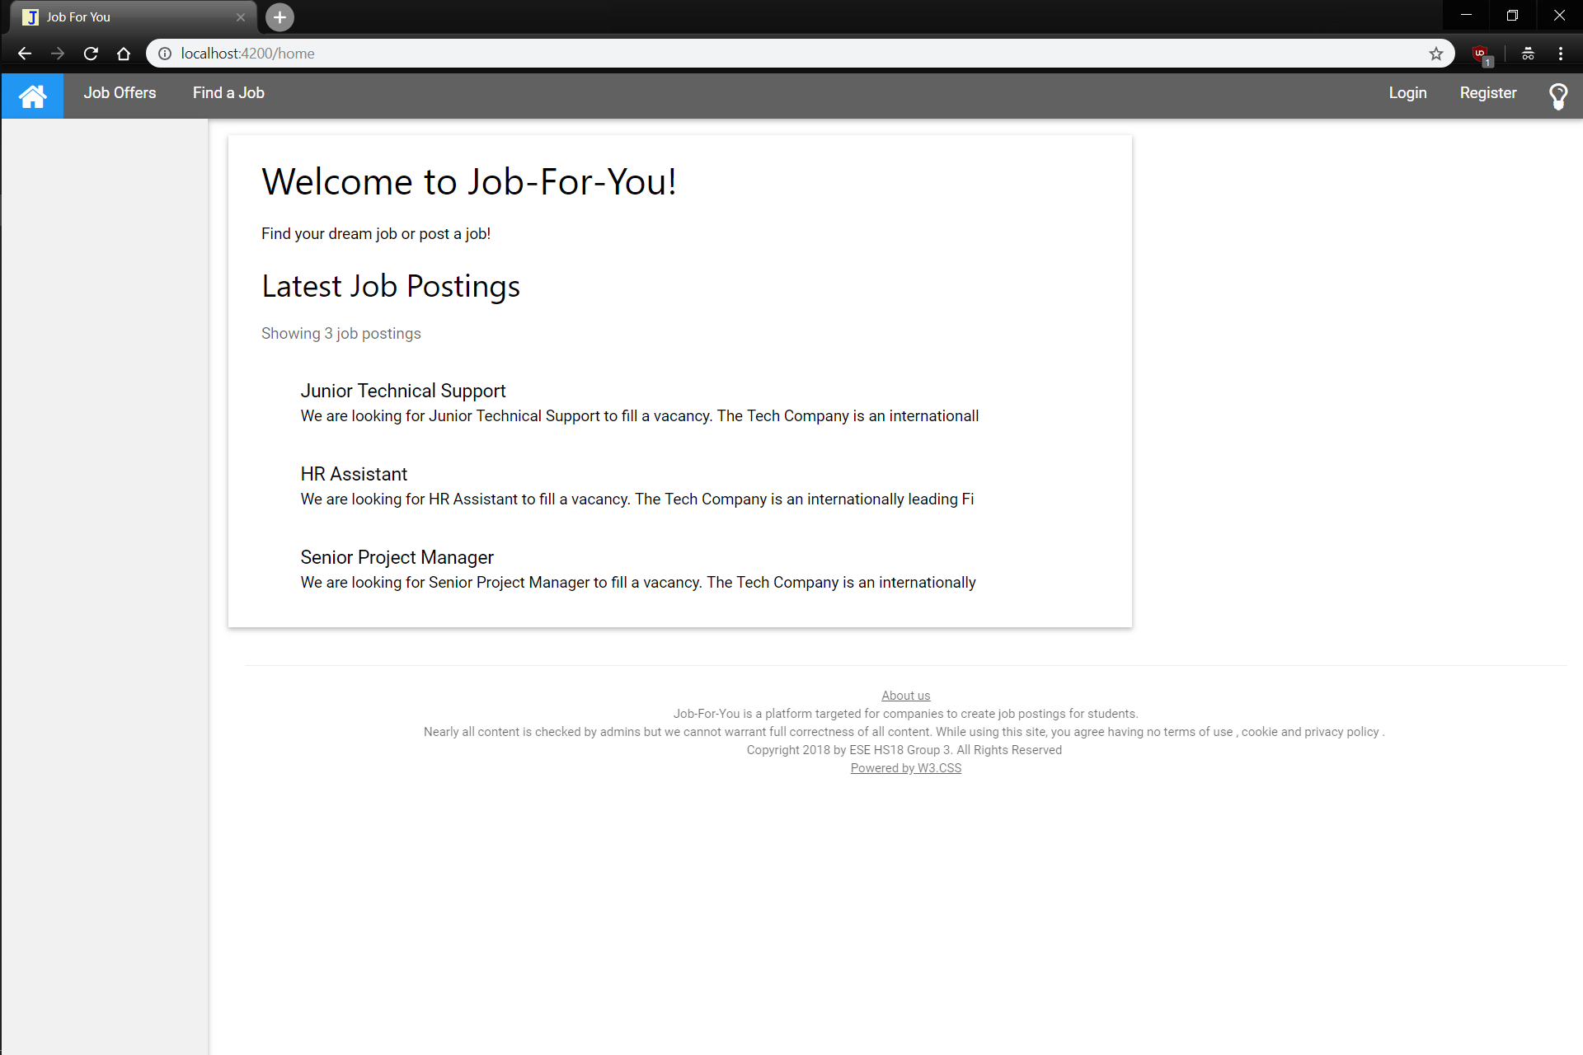
Redundant links / messages will not be displayed on subsequent pages
Redirect to ‘Home’, Job Offers or Find a Job (Search)
Login / Register lead to respective components. Lightbulb (on click) changes to night theme
Clicking on a job leads to details for that job
Redirect to About Us Page

Slide 2
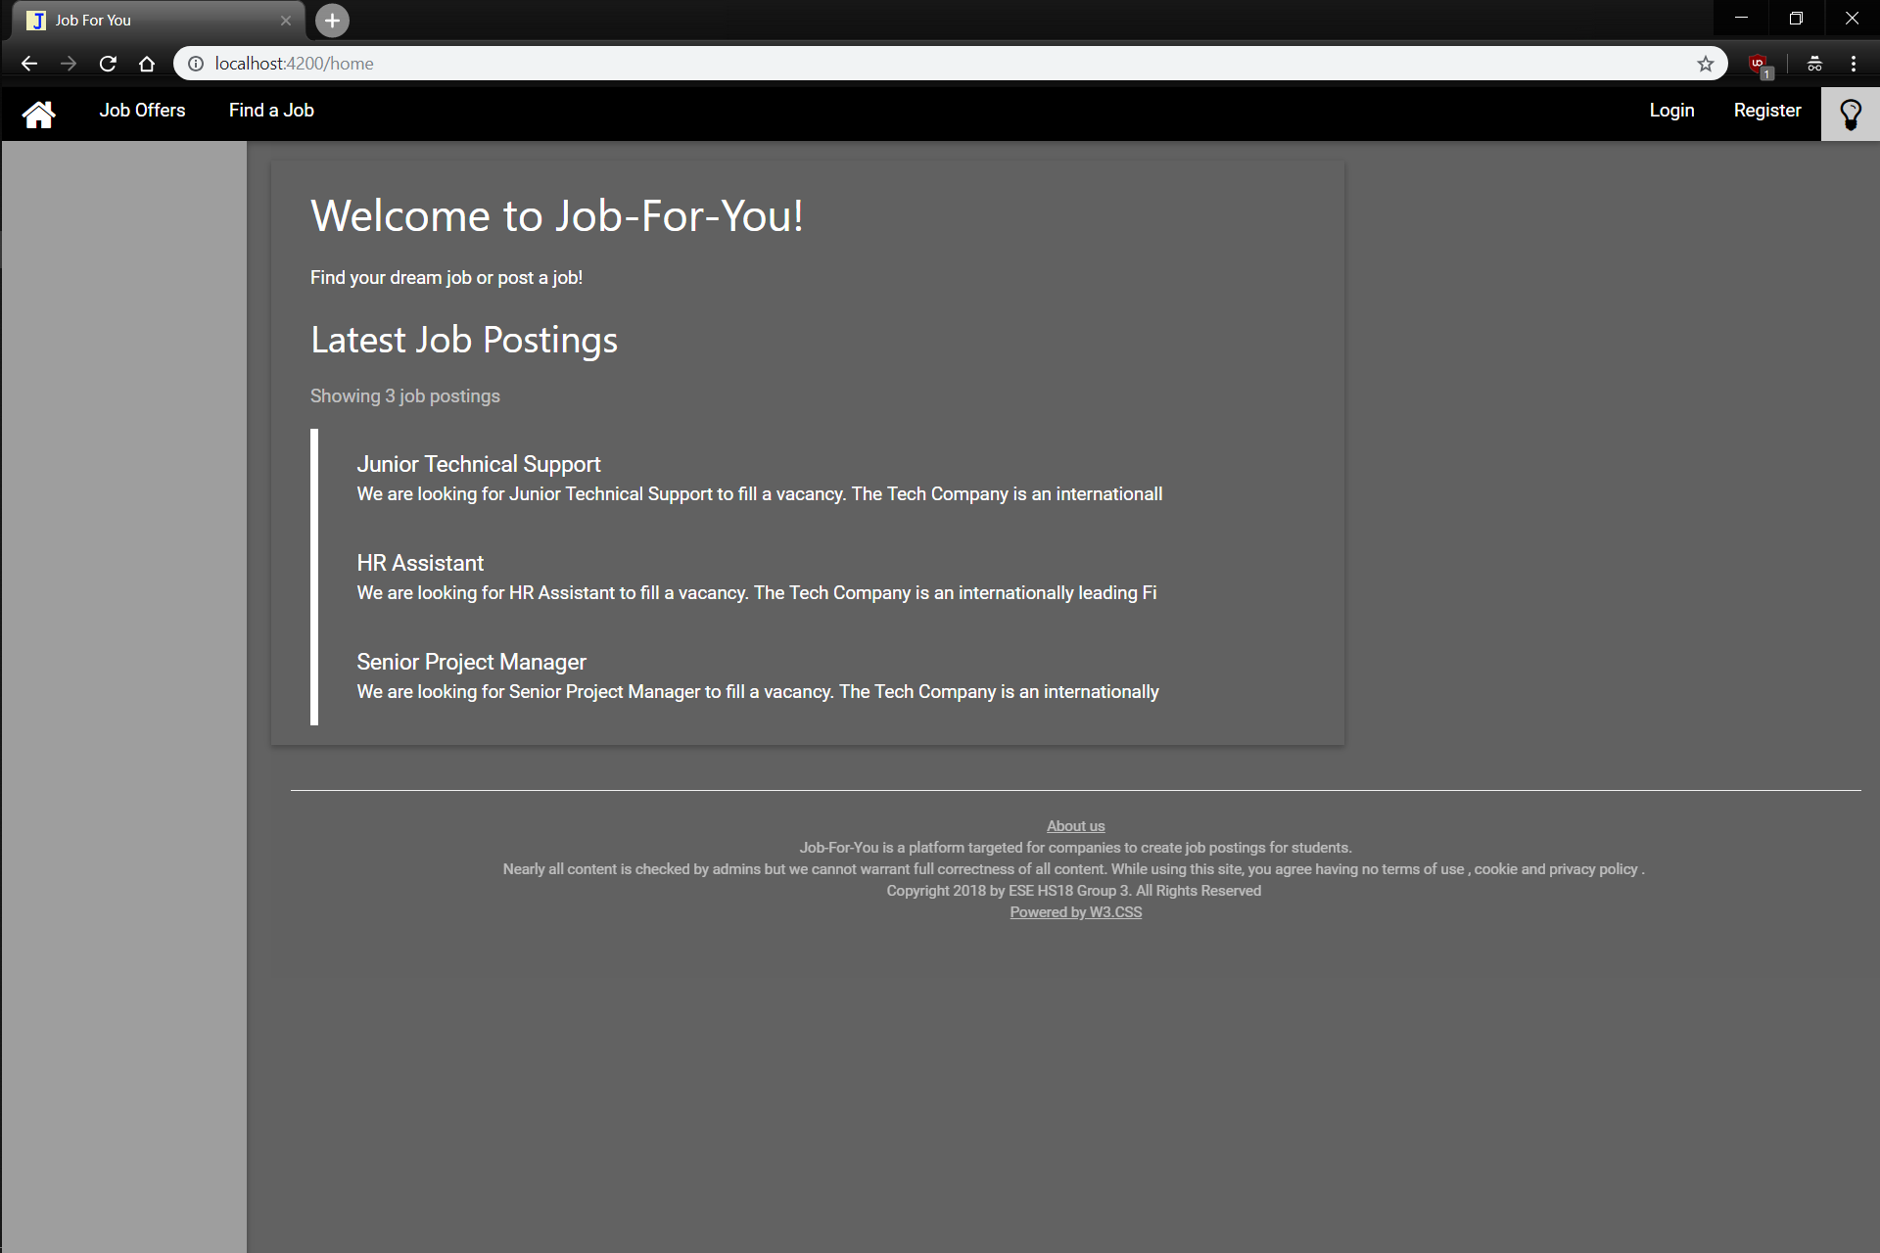

Slide 3
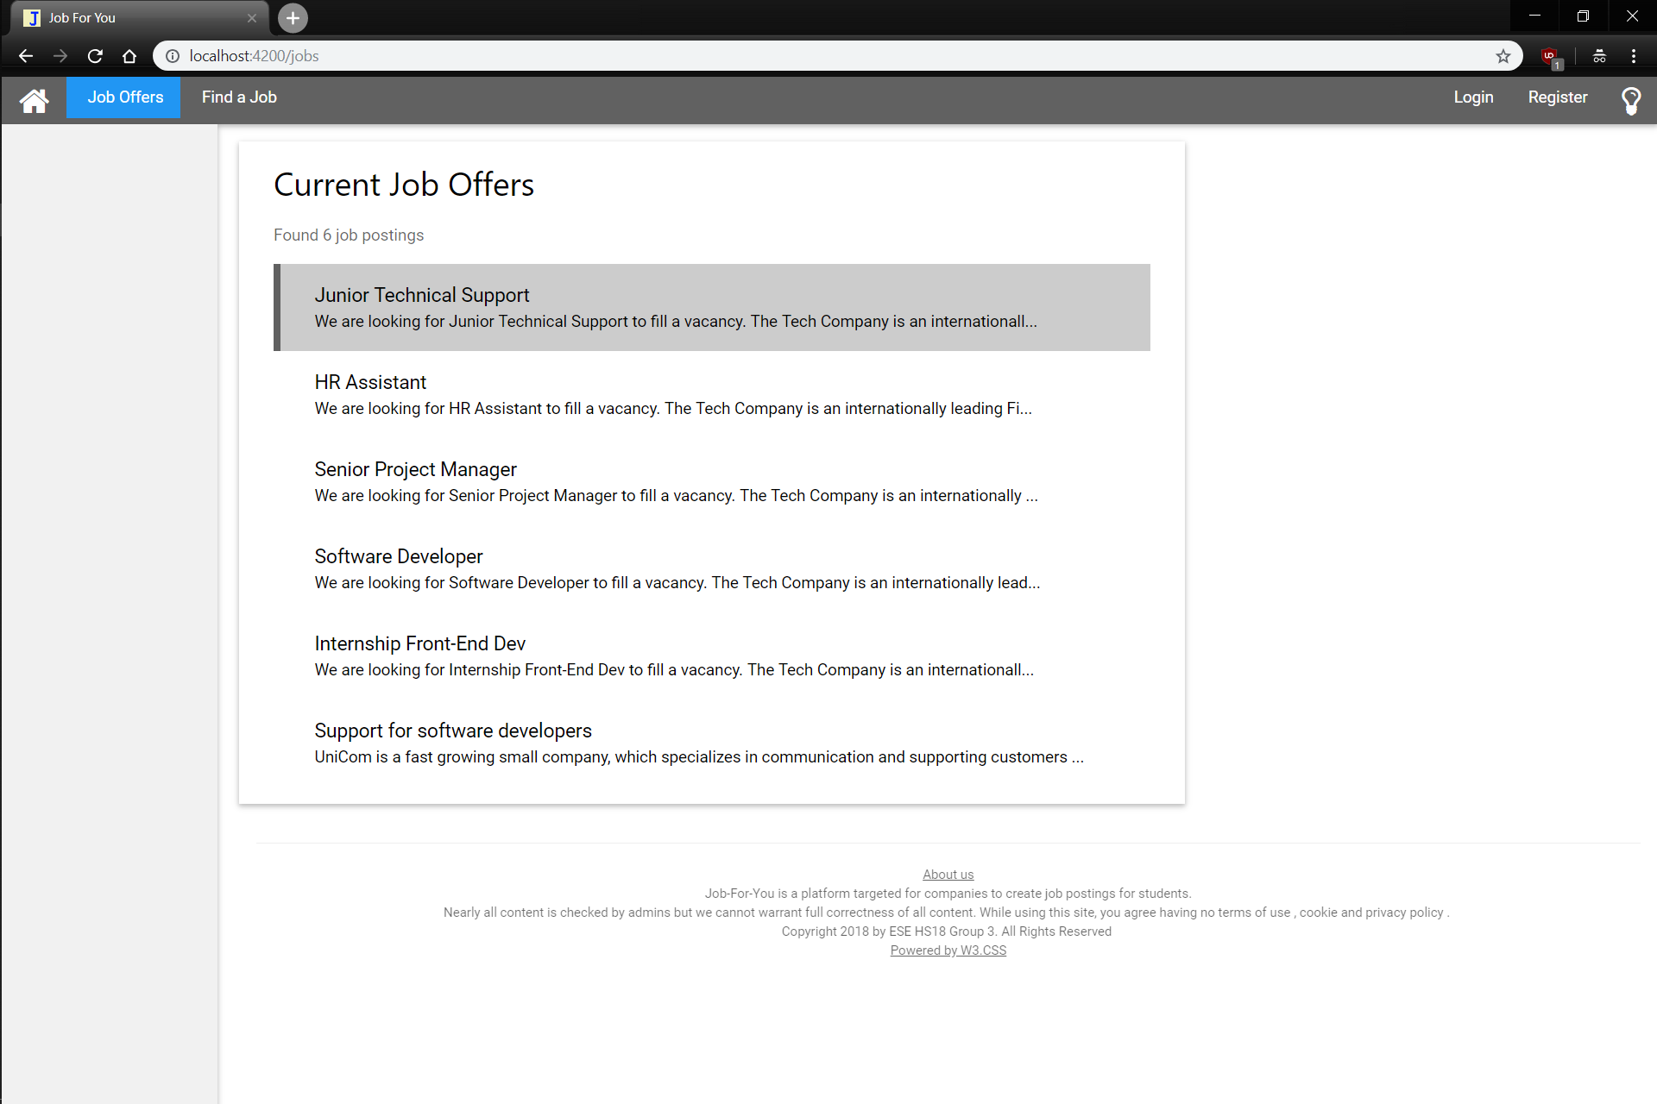

Clicking on a job leads to details for that job, the job where the mouse hovers has a highlight

Slide 4
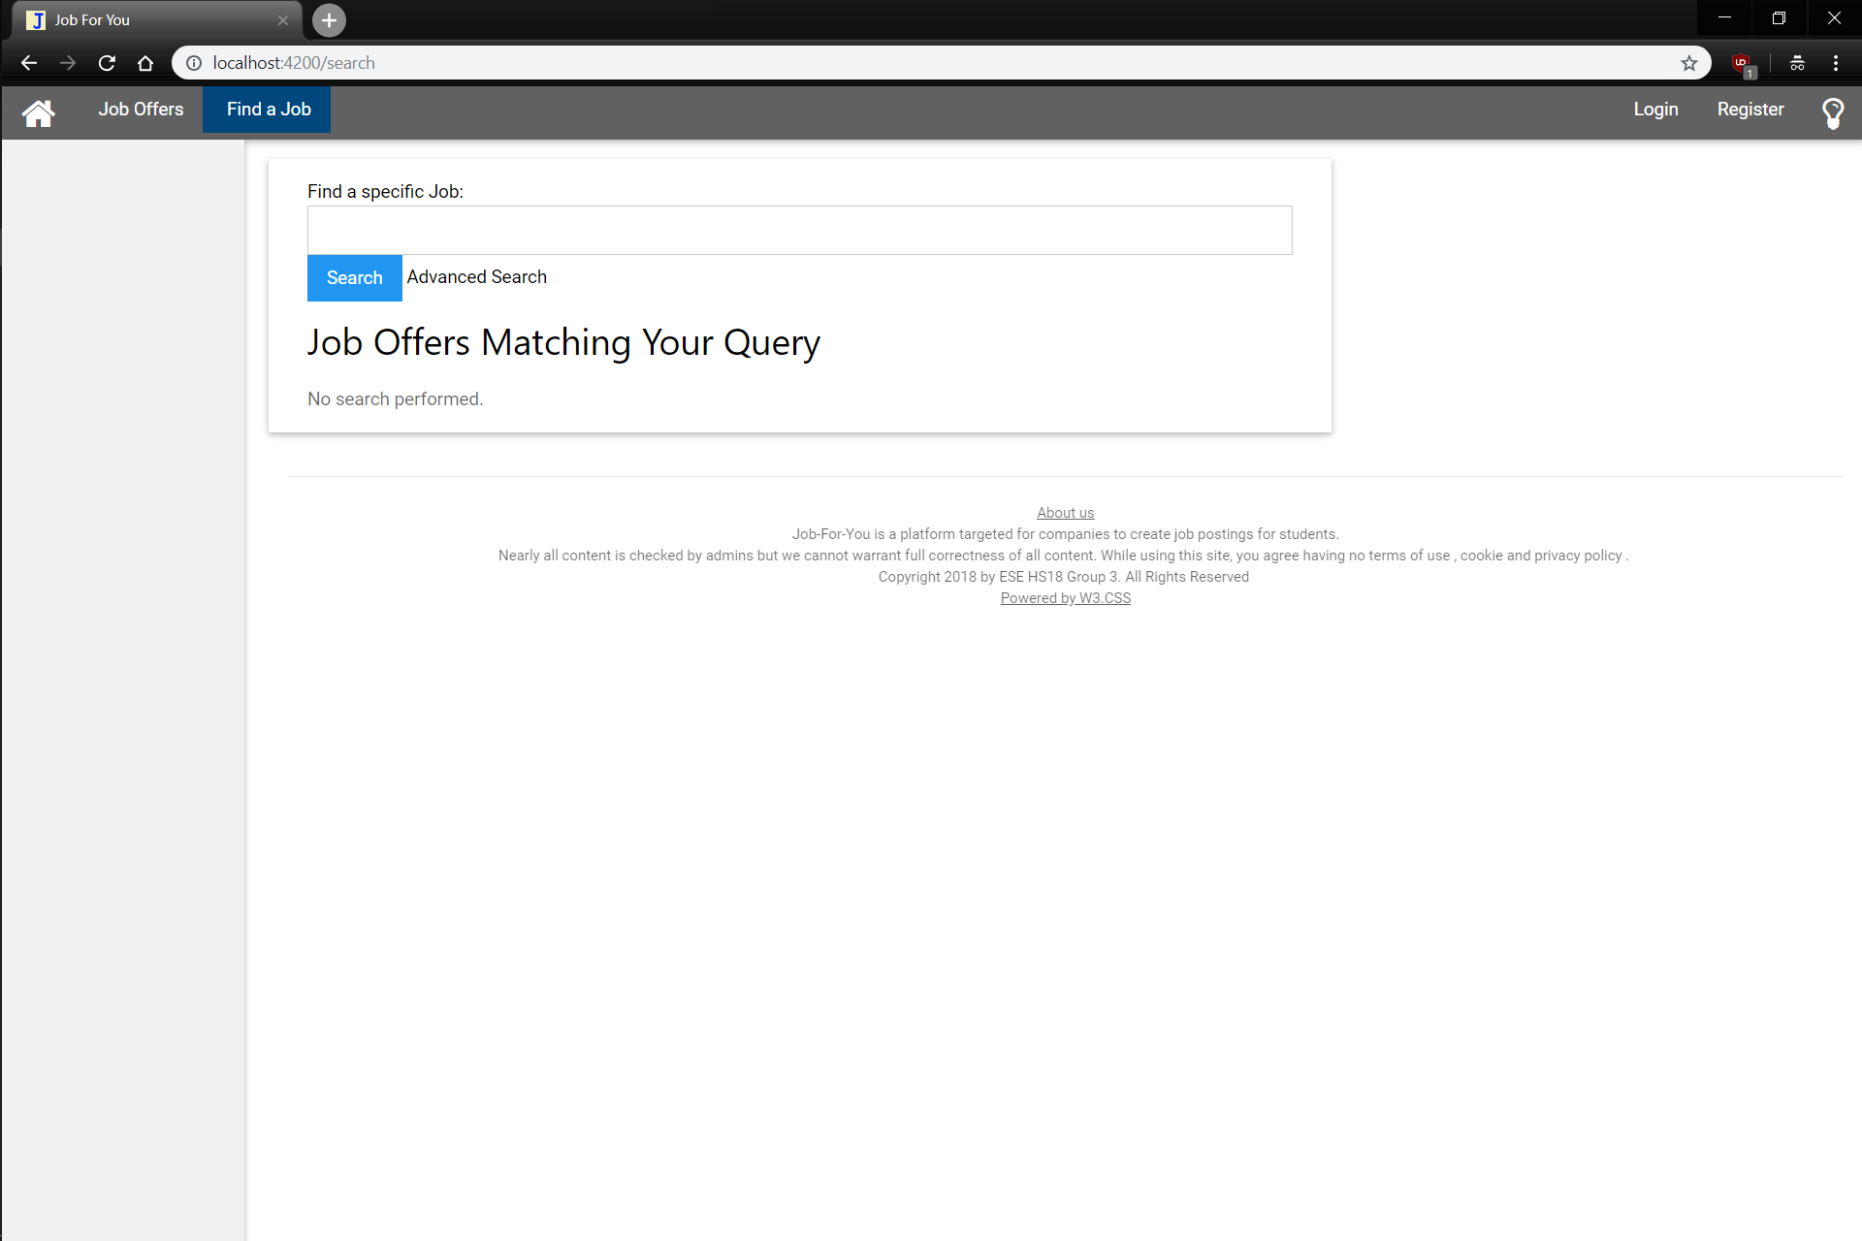
Entering a search term and pressing ‘Enter’ or the Search button. Alternatively there is the Advanced Search

Slide 5
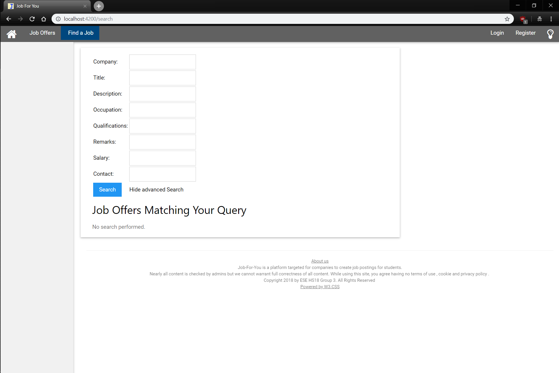
Search with the various criterias or back to Simple Search

Slide 6
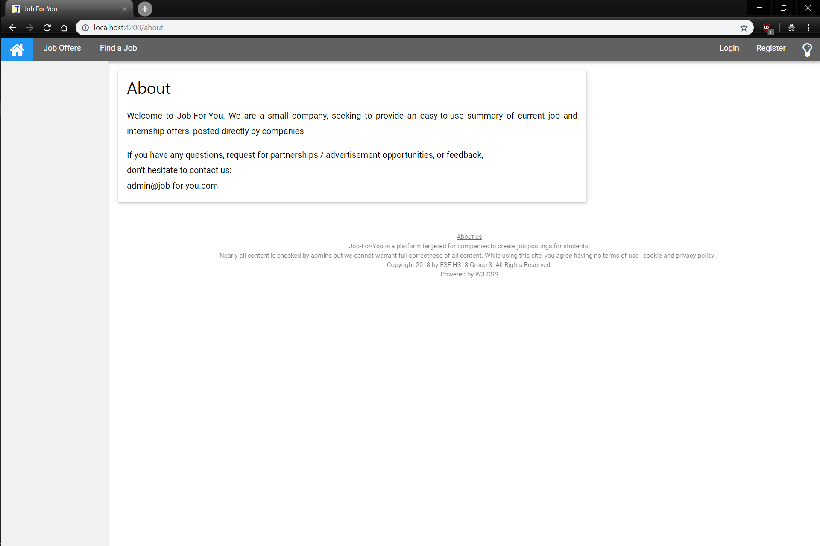
Entering a search term and pressing ‘Enter’ or the Search button searches job titles for matches
No additional comments needed

Slide 7
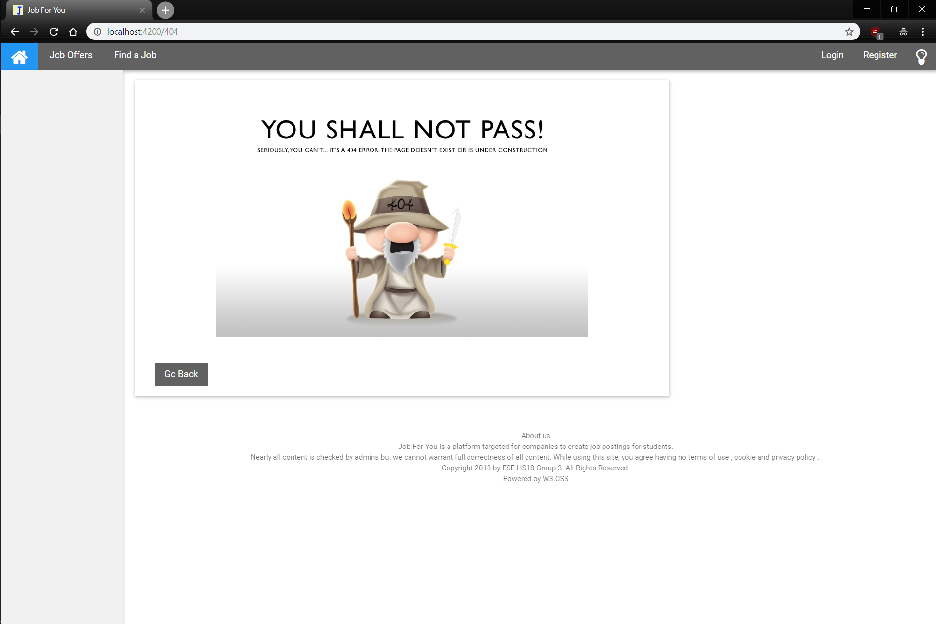
Entering / clicking any invalid URL redirects here
Redirects to the last visited page

Slide 8
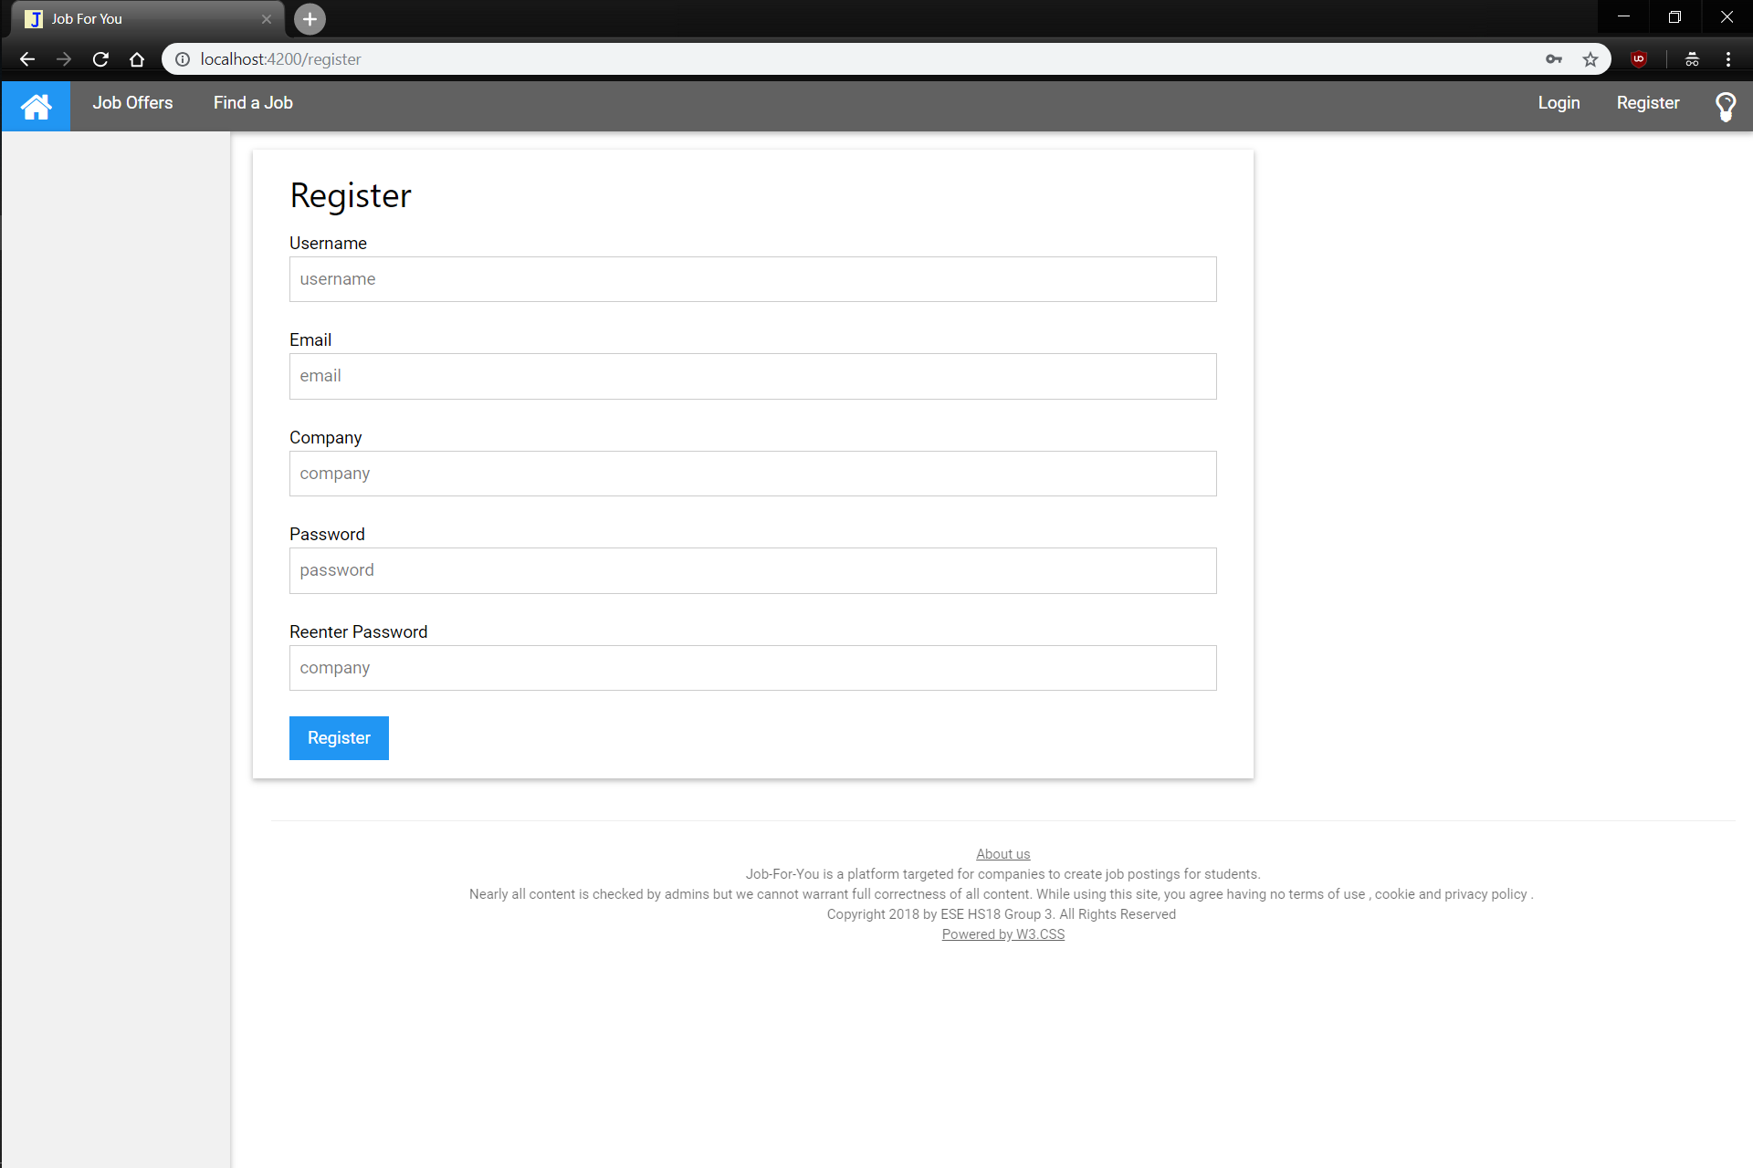
Submit the Form, Password must have a minimum length of 6 (error message otherwise)

Slide 9
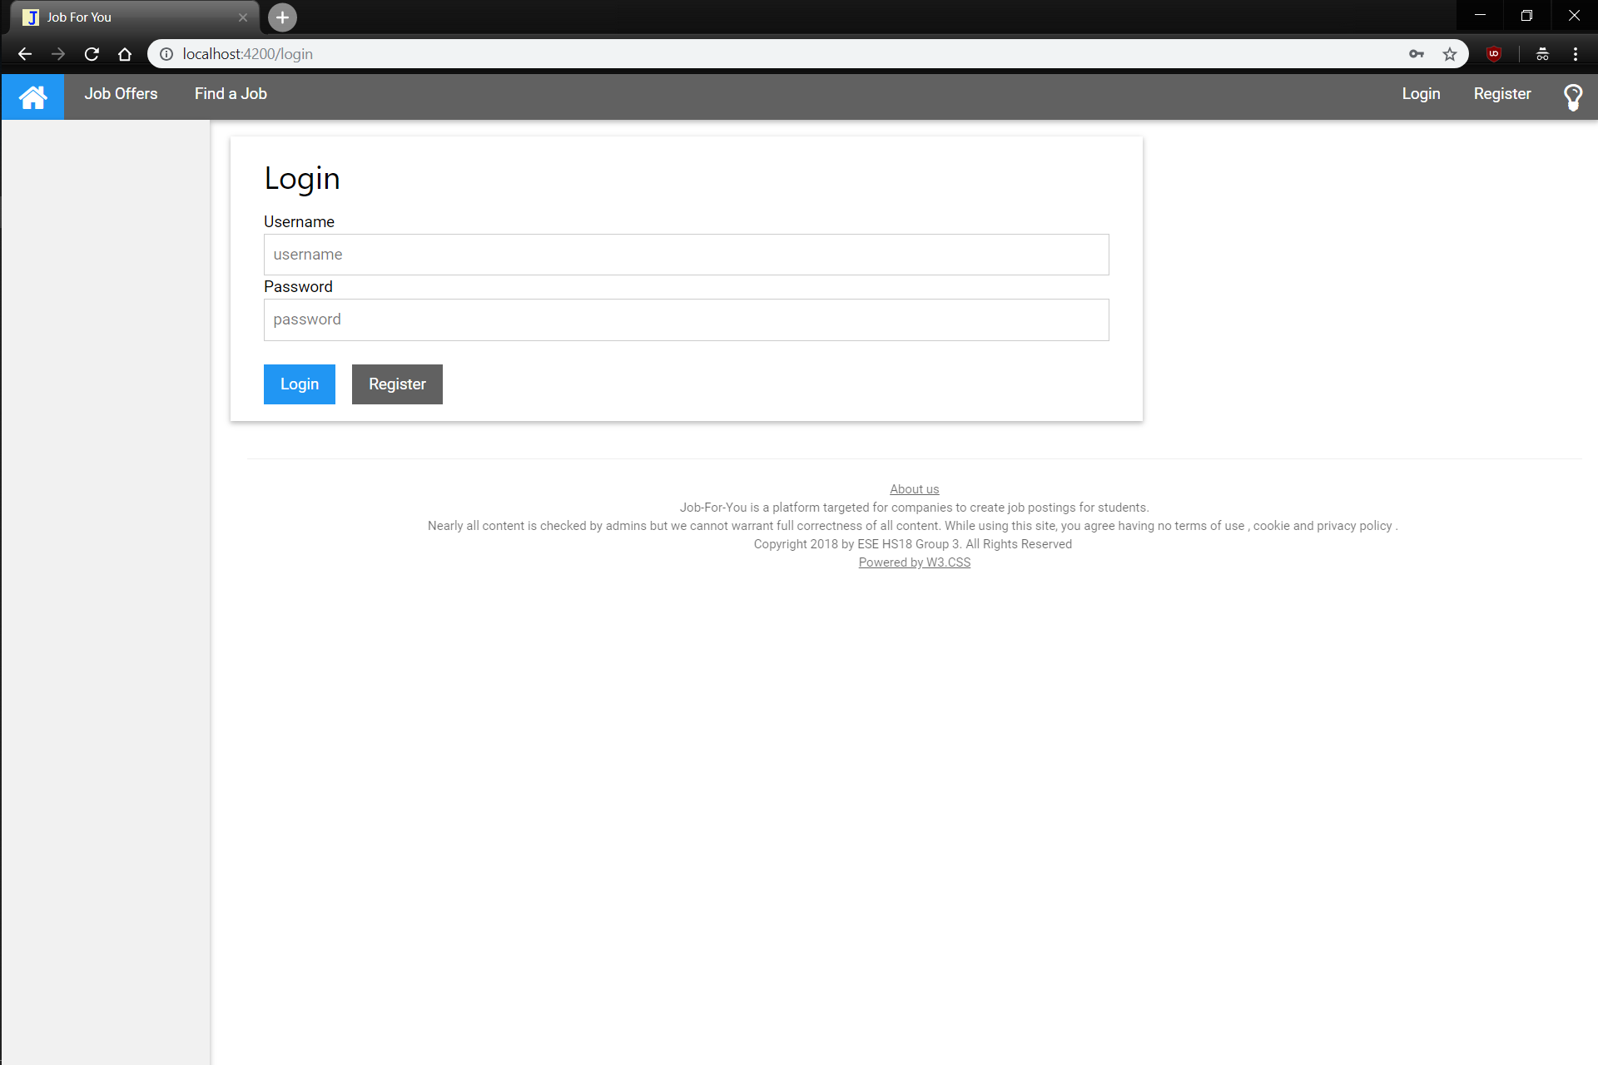
Login with your credentials or go to Registration Form

Slide 10
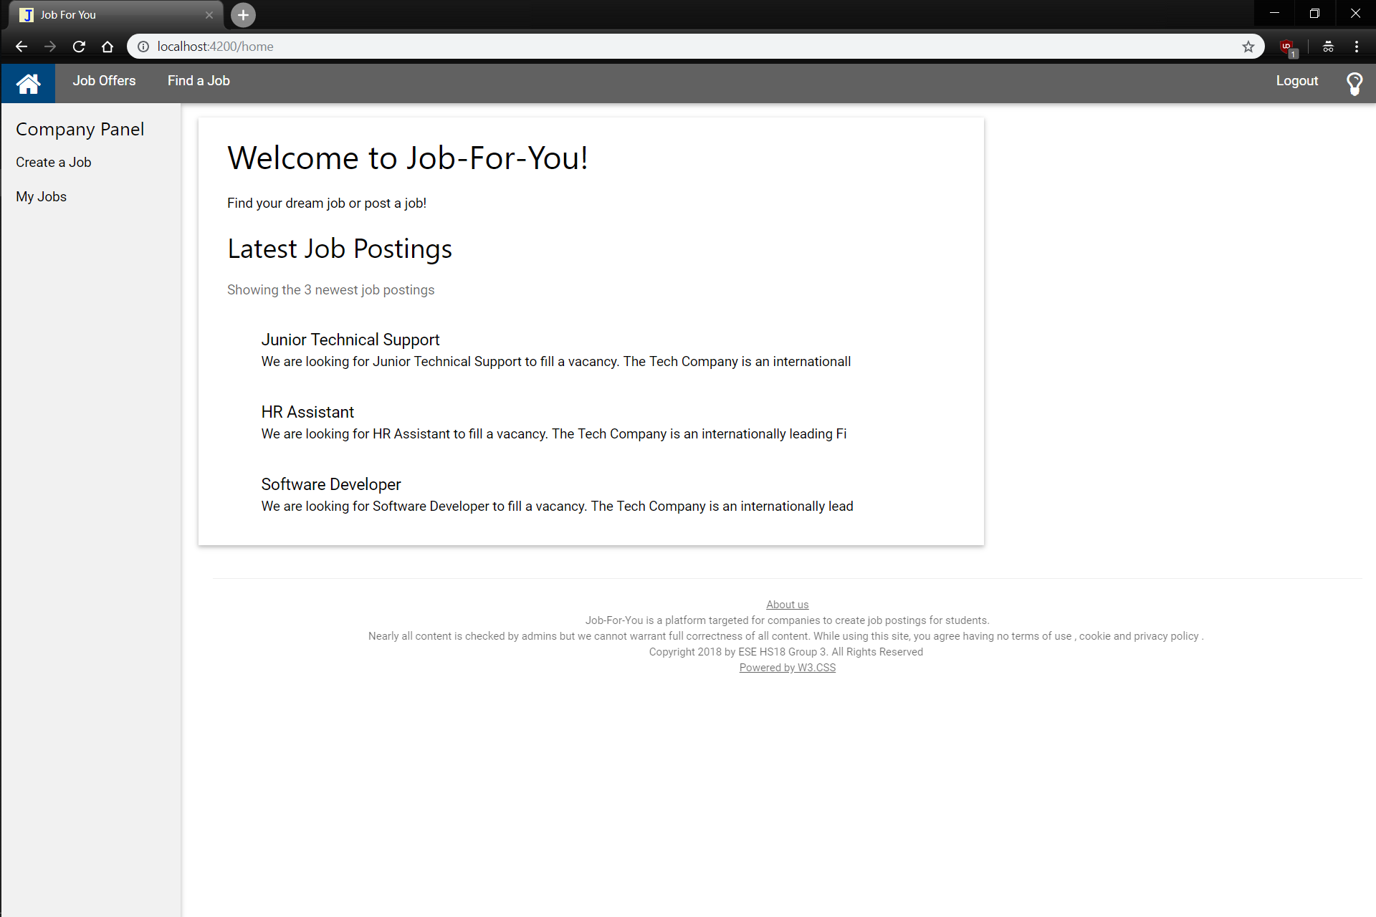
If logged in as a company (and not the admin) you get the following side-panel and the new navigation-bar entry
Redirects to Create a Job Form (Create a Job) or View Your Jobs (My Jobs)

Slide 11
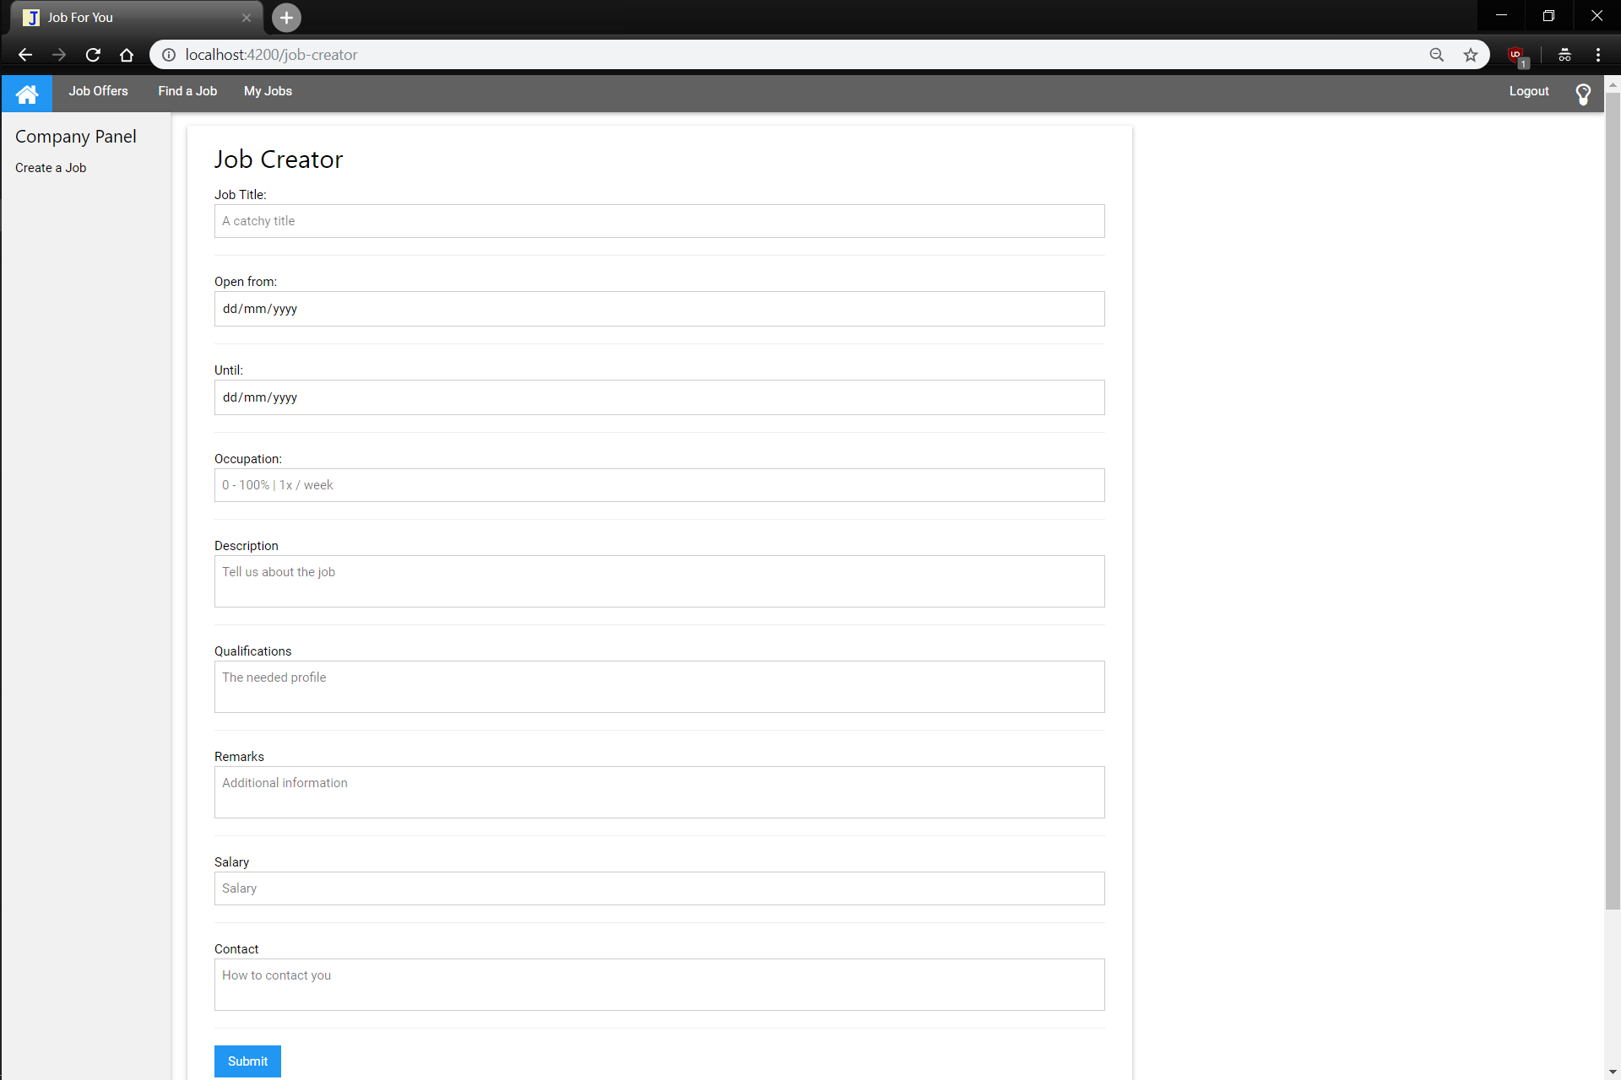
The form should be self-explantory, error if information not filled in

Slide 12
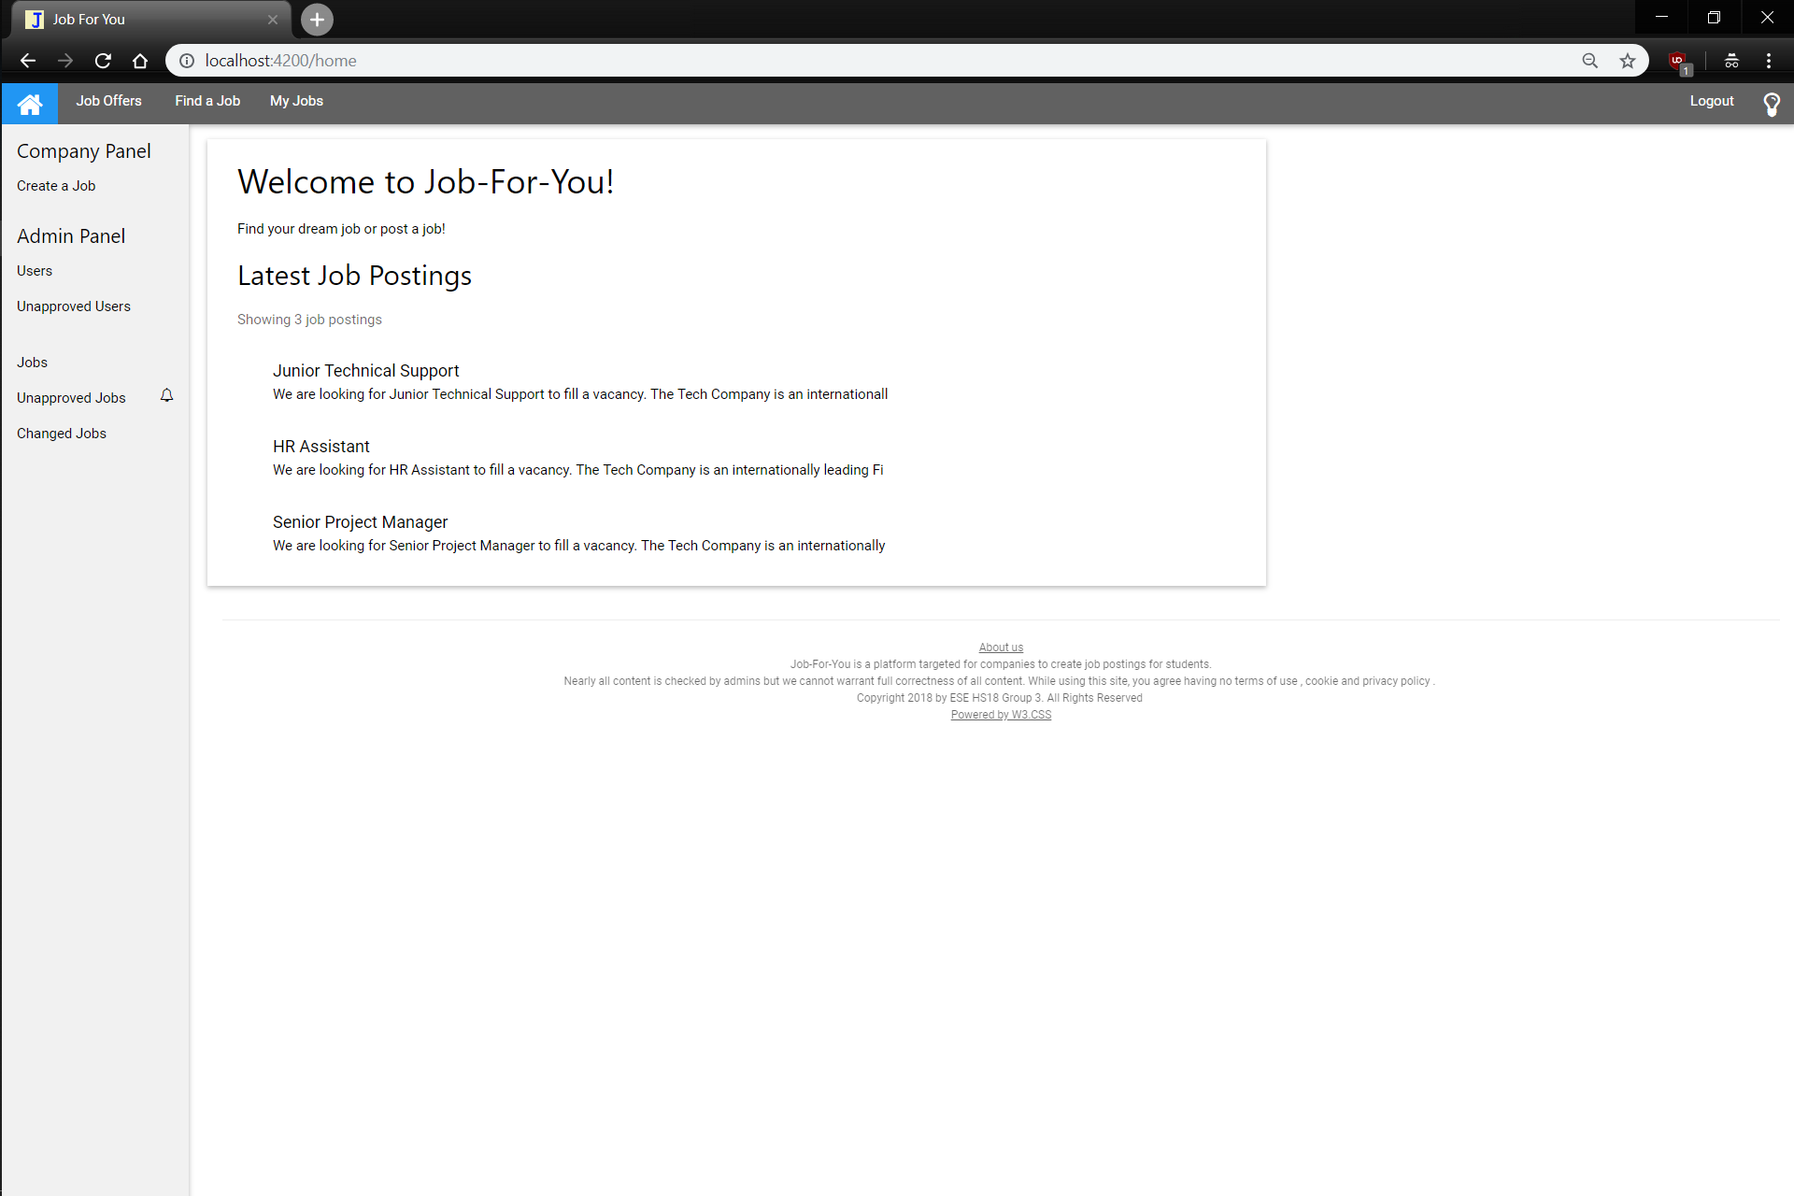
If logged in as admin you get an addition to the side-panel
The bells notify you of open tasks

Slide 13
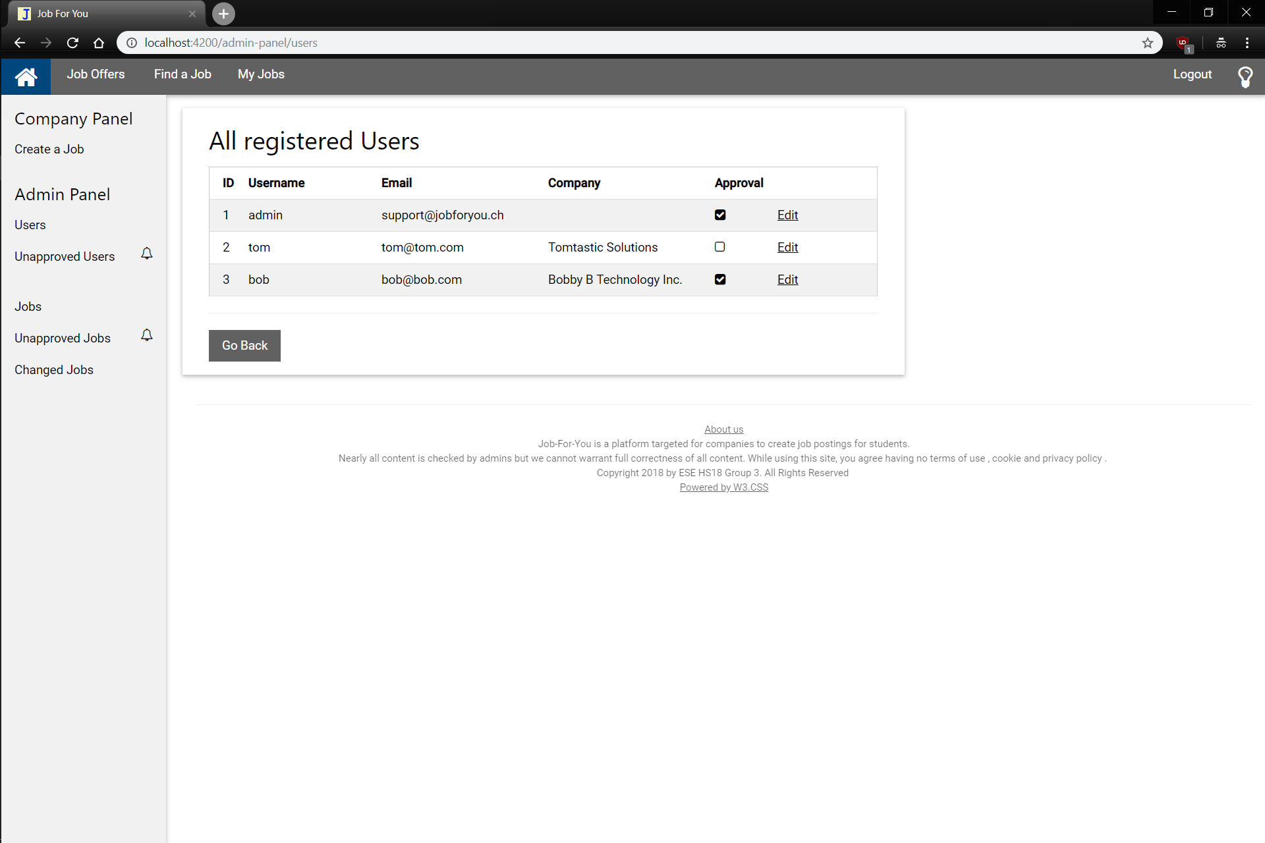
Unapproved Users are denoted and other notable information is listed
Redirect to User Edit

Slide 14
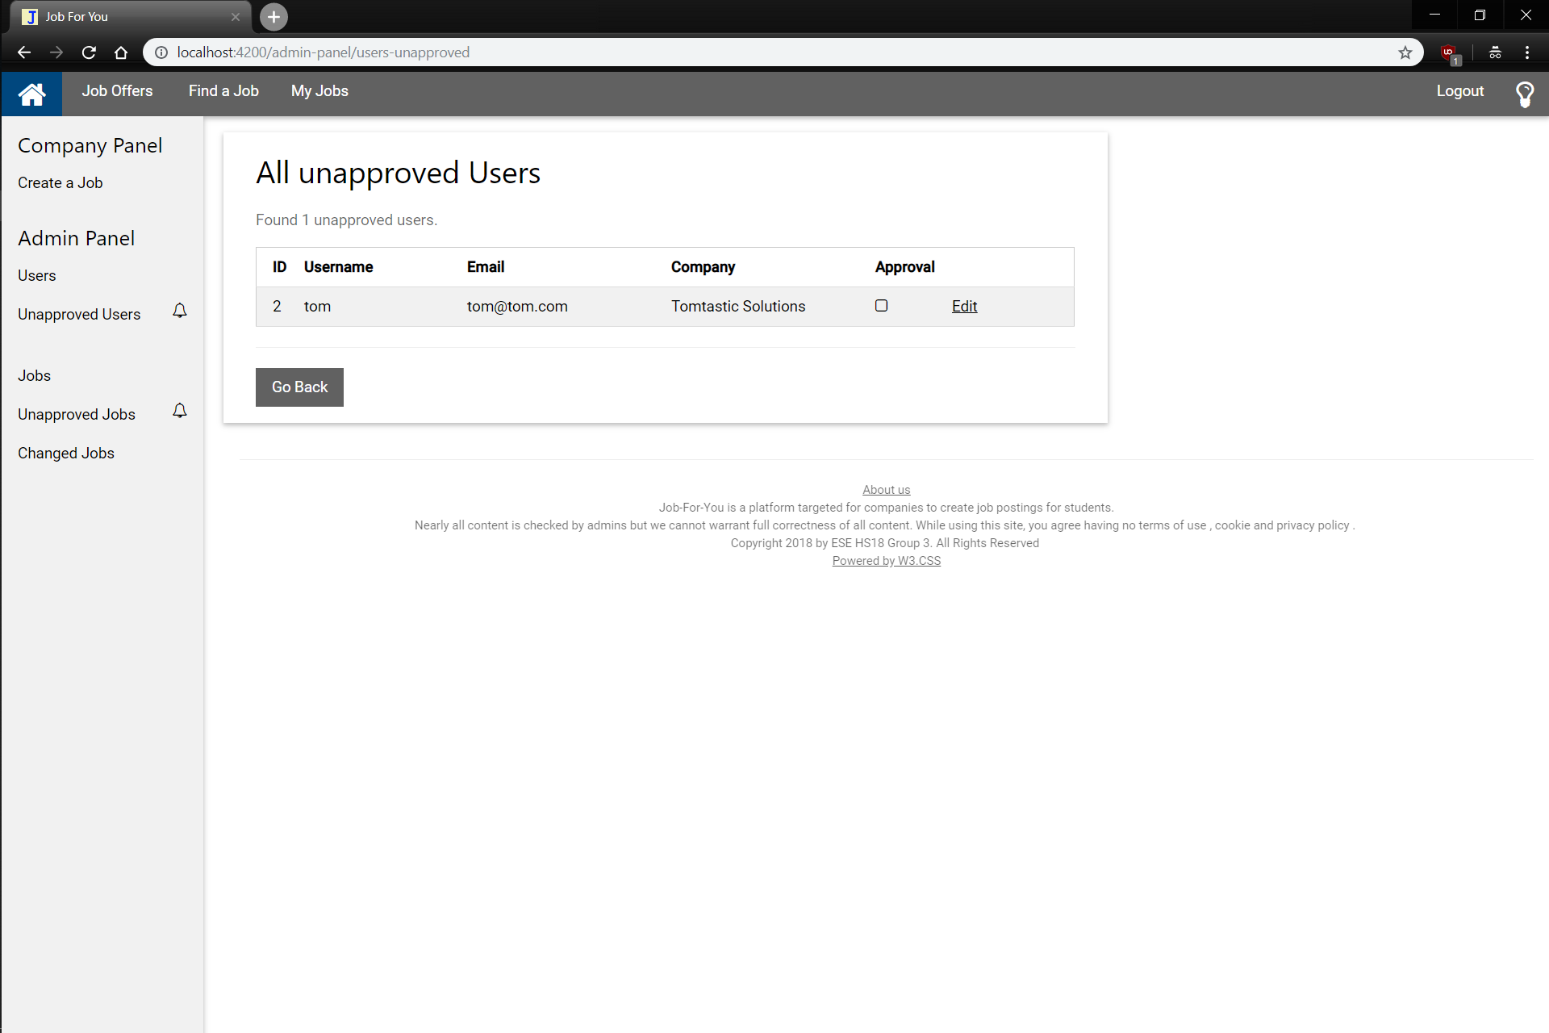
Only shows unapproved Users for ease of approving

Slide 15
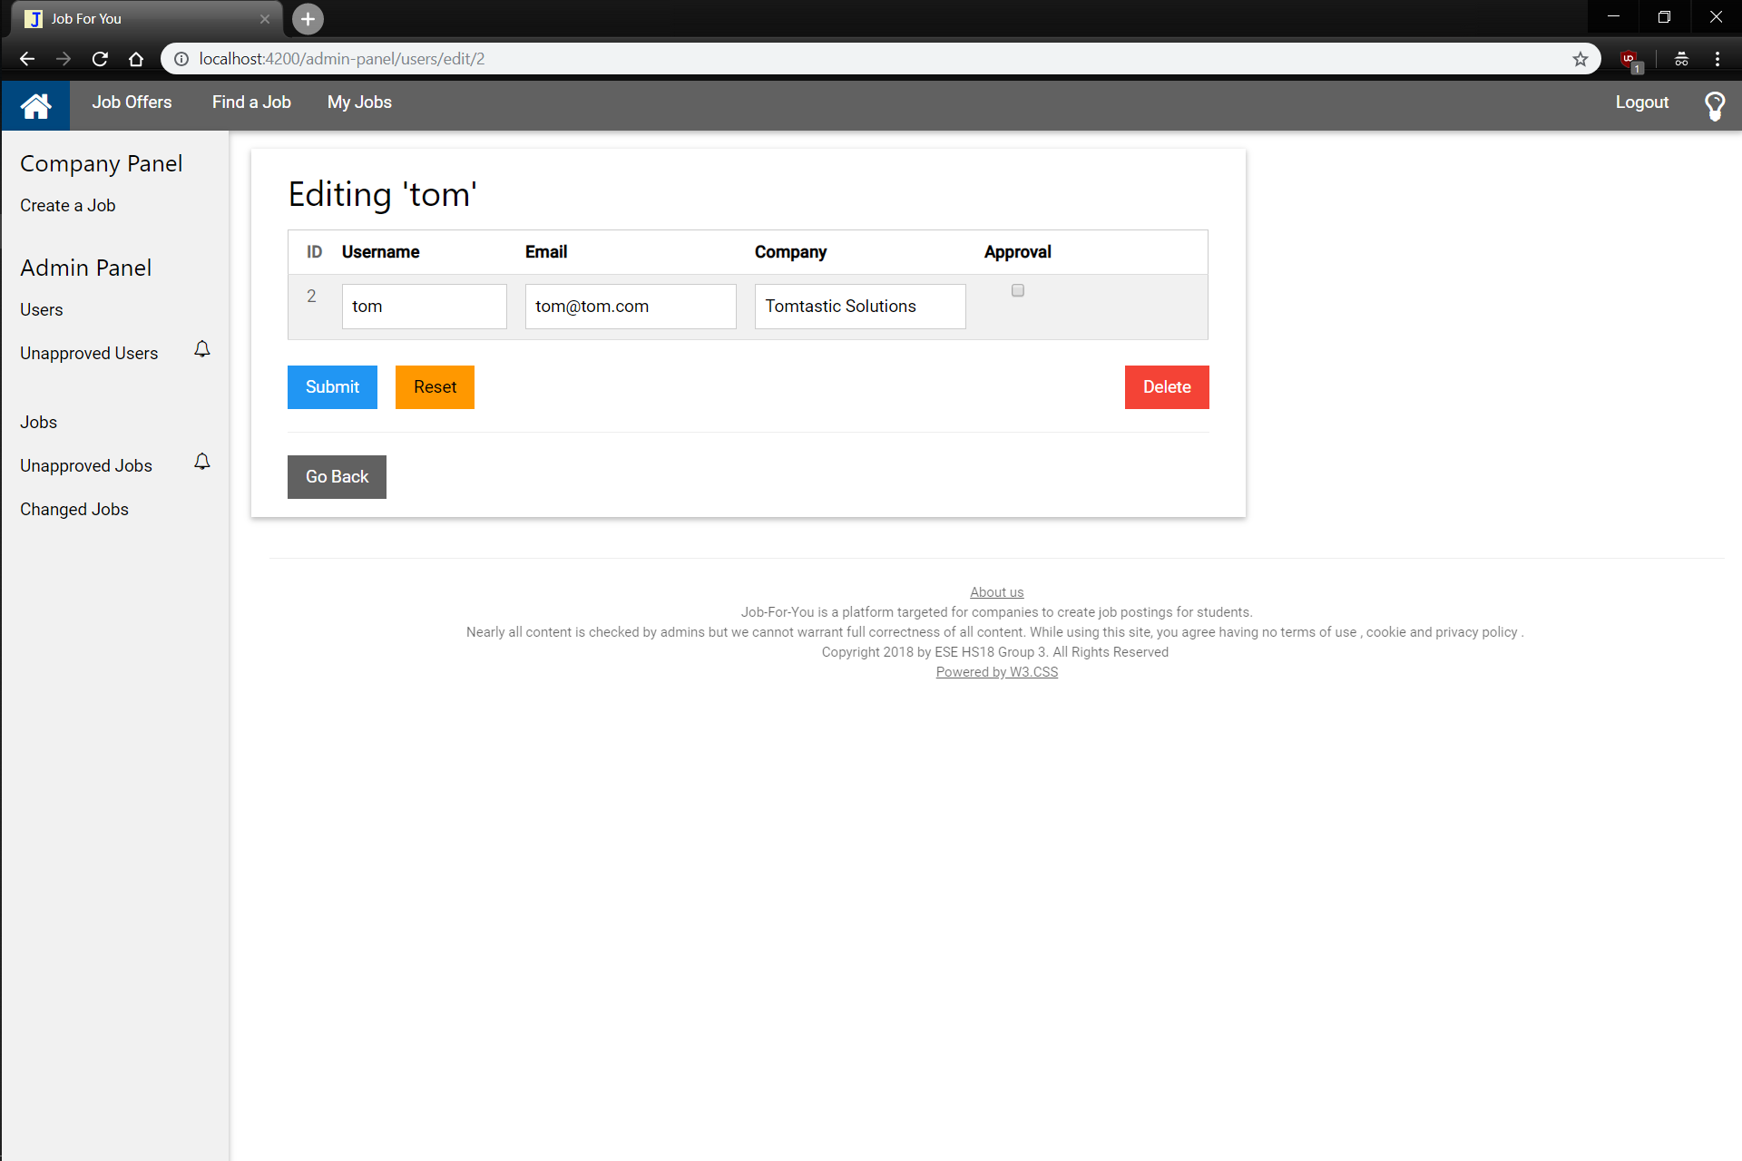
Editing a User shows their name, and their prior information / credentials
Reset Data of User
Delete User with Confirmation
Saves the Information

Slide 16
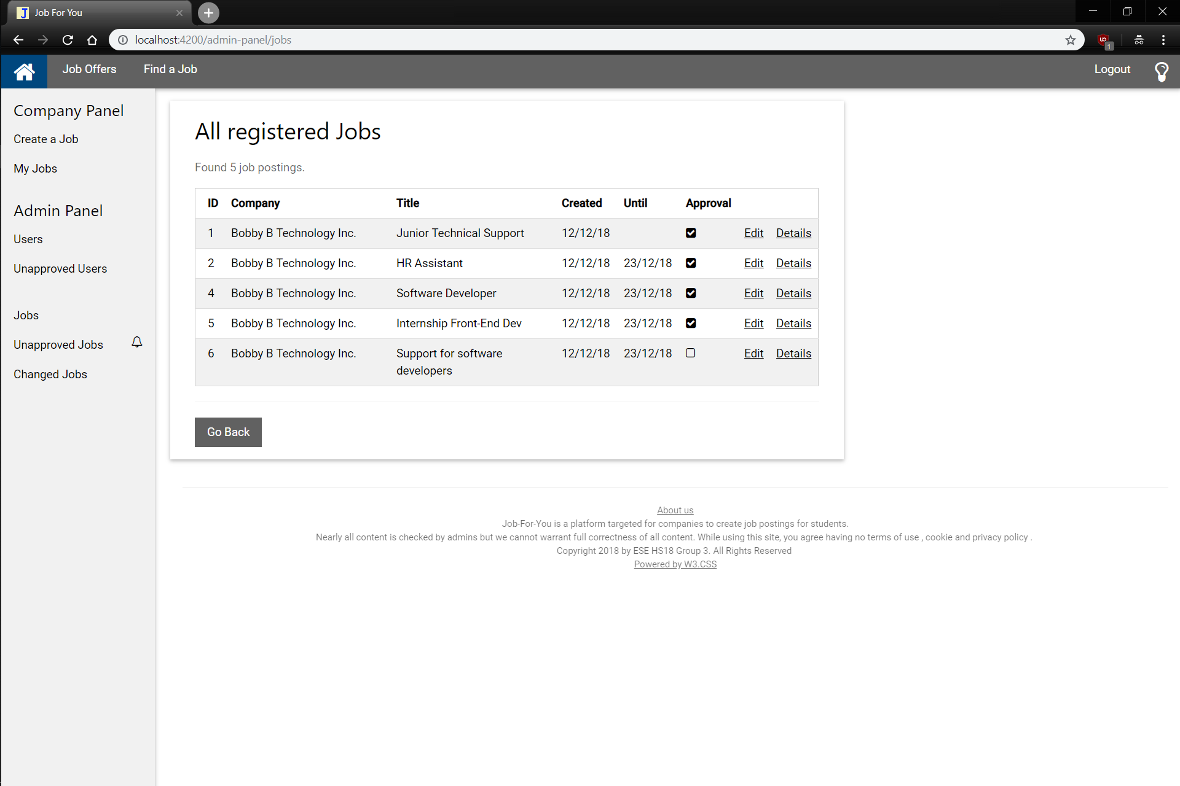
Shows all Jobs, if they are approved or not and some detail
Edit the Job or show Full Job Details like in Job Offers

Slide 17
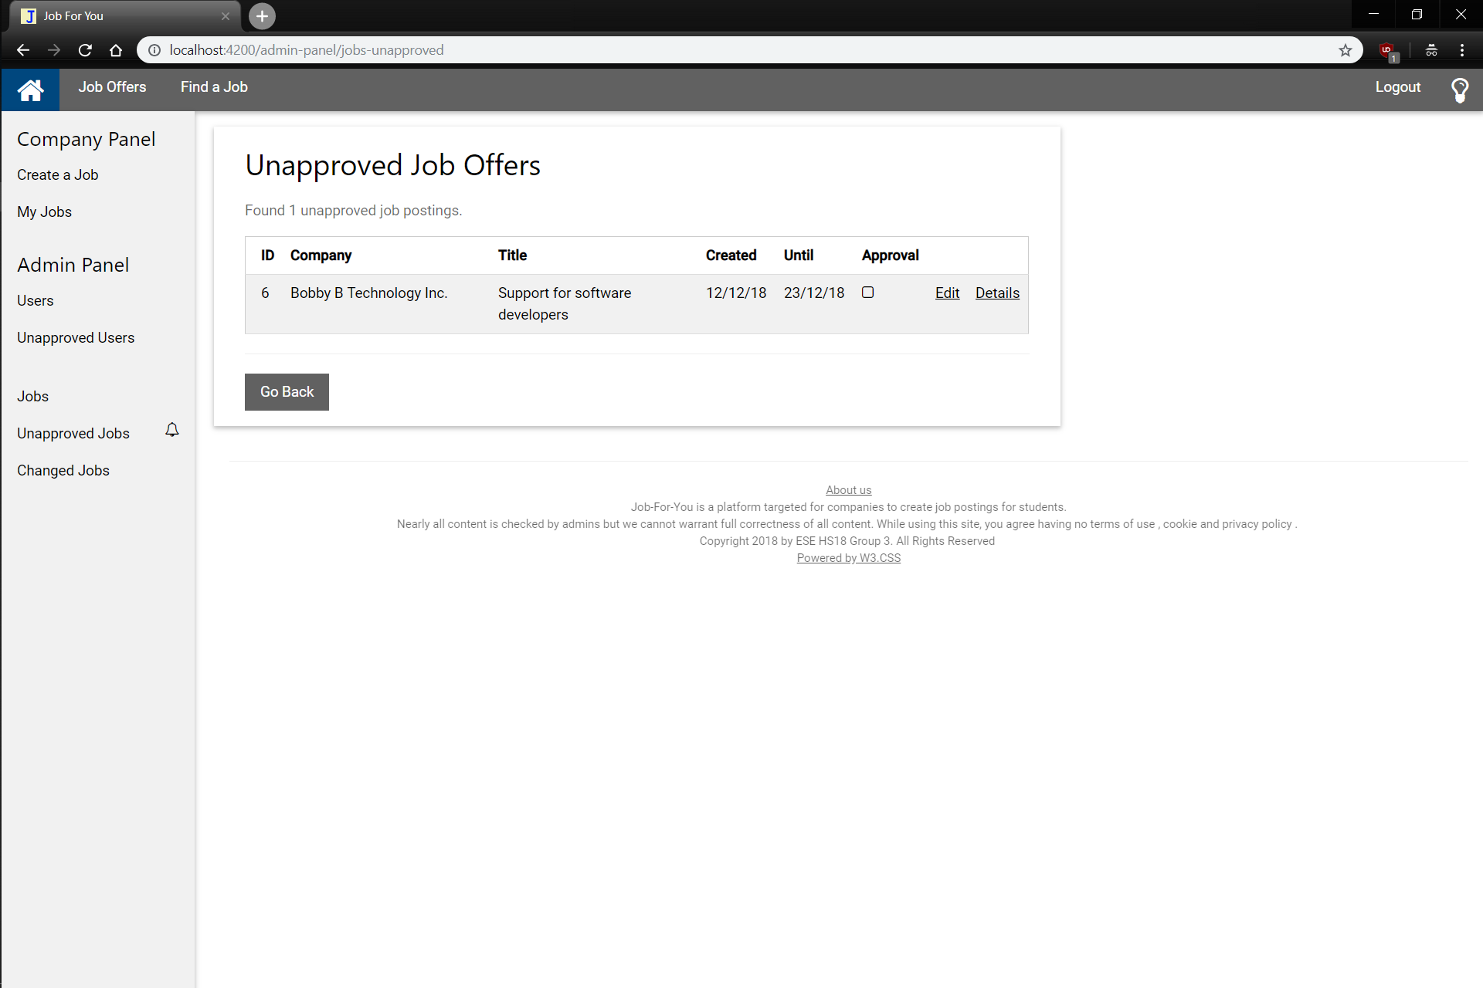
Shows only the unapproved jobs

Slide 18
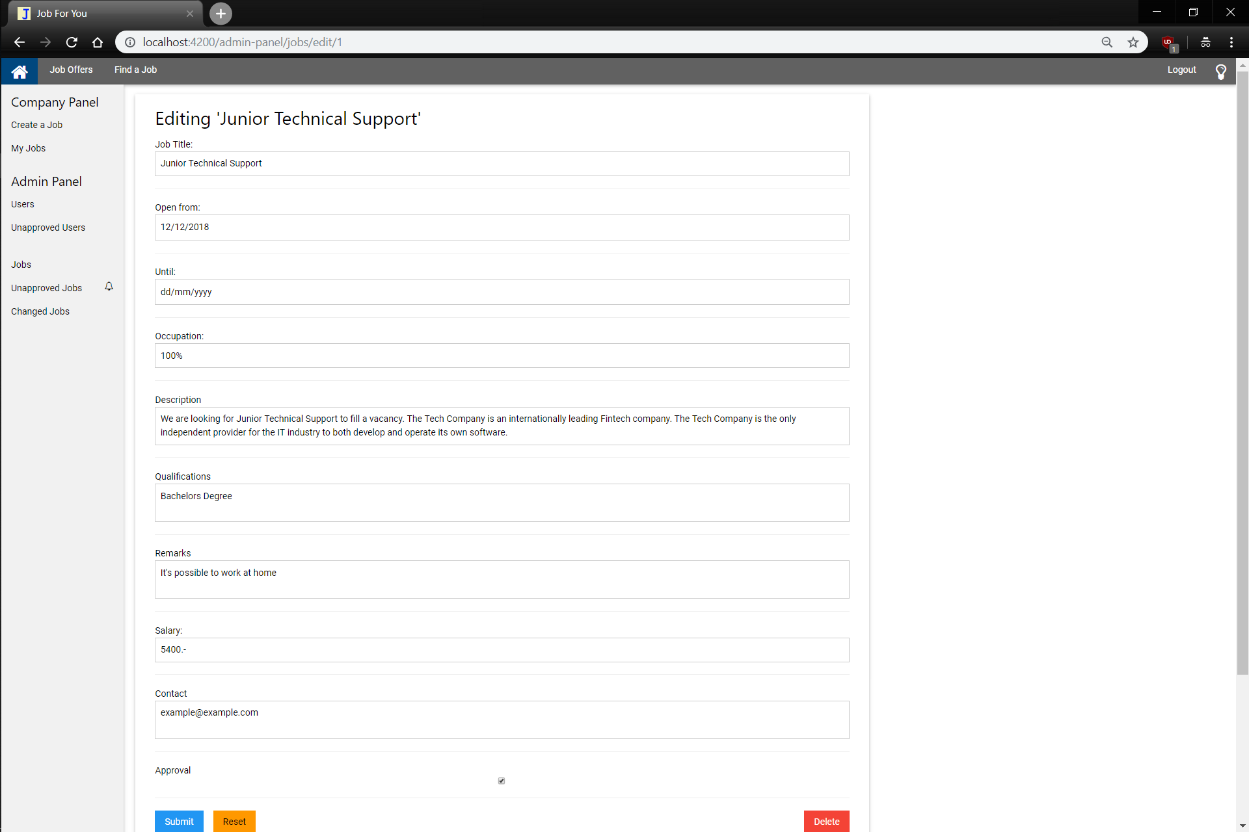
When an admin edits a job, he/she can change any details and either Submit, Reset or Delete (with confirmation)

